Slide 1

CSC/CPE 138 - Computer Network Fundamentals
The Link Layer and LANs
The presentation was adapted from the textbook: Computer Networking: A Top-Down Approach 8th edition Jim Kurose, Keith Ross, Pearson, 2020

Slide 2

Link layer, LANs: roadmap
introduction
error detection, correction
multiple access protocols
LANs
addressing, ARP
Ethernet
switches
VLANs
link virtualization: MPLS
data center networking
a day in the life of a web request

Slide 3
Error detection
EDC: error detection and correction bits (e.g., redundancy)
D: data protected by error checking, may include header fields
datagram
datagram
Error detection not 100% reliable!
protocol may miss some errors, but rarely
larger EDC field yields better detection and correction
otherwise
all
bits in D’
OK
?
N
detected
error
d data bits
D
EDC
D’
EDC’
bit-error prone link

Slide 4
Parity checking
single bit parity:
detect single bit errors
two-dimensional bit parity:
detect and correct single bit errors
row parity
0111000110101011
1
d_{1,1}
. . .
d_{1,j}
d_{1,j+1}
d data bits
d_{2,1}
. . .
d_{2,j}
d_{2,j+1}
parity
bit
. . .
. . .
. . .
. . .
d_{i,1}
. . .
d_{i,j}
d_{i,j+1}
column
parity
d_{i+1,1}
. . .
d_{i+1,j}
d_{i+1,j+1}
Even parity: set parity bit so there is an even number of 1’s
no errors:
1 0 1 0 1 1
detected
and
correctable
single-bit
error:
1 0 1 0 1 1
1 1 1 1 0 0
1 0 1 1 0 0
parity
error
0 1 1 1 0 1
0 1 1 1 0 1
0 0 1 0 1 0
0 0 1 0 1 0
parity
error

Slide 5
Internet checksum (review)
Goal: detect errors (i.e., flipped bits) in transmitted segment
sender:
treat contents of UDP segment (including UDP header fields and IP addresses) as sequence of 16-bit integers
checksum: addition (one’s complement sum) of segment content
checksum value put into UDP checksum field
receiver:
compute checksum of received segment
check if computed checksum equals checksum field value:
not equal - error detected
equal - no error detected. But maybe errors nonetheless? More later ….

Slide 6
Cyclic Redundancy Check (CRC)
more powerful error-detection coding
D: data bits (given, think of these as a binary number)
G: bit pattern (generator), of r+1 bits (given)
r CRC bits
d data bits
D
R
bit pattern
<D,R> = D 2^{r} XOR R
formula for bit pattern
*
goal: choose r CRC bits, R, such that <D,R> exactly divisible by G (mod 2)
receiver knows G, divides <D,R> by G. If non-zero remainder: error detected!
can detect all burst errors less than r+1 bits
widely used in practice (Ethernet, 802.11 WiFi)

Slide 7
Cyclic Redundancy Check (CRC): example
G
We want:
D.2^{r} XOR R = nG
1
0
1
0 1 1
1 0 0 1
1 0 1 1 1 0
0 0 0
or equivalently:
D.2^{r} = nG XOR R
1 0 0 1
1 0 1
D
2^{r}
0 0 0
*
or equivalently:
if we divide D.2^{r} by G, want remainder R to satisfy:
1 0 1 0
1 0 0 1
1 1 0
0 0 0
D.2^{r}
G
1 1 0 0
R = remainder [ ]
1 0 0 1
1 0 1 0
1 0 0 1
0 1 1
R

Slide 8
Link layer, LANs: roadmap
introduction
error detection, correction
multiple access protocols
LANs
addressing, ARP
Ethernet
switches
VLANs
link virtualization: MPLS
data center networking
a day in the life of a web request

Slide 9









Multiple access links, protocols
two types of “links”:
point-to-point
point-to-point link between Ethernet switch, host
PPP for dial-up access
broadcast (shared wire or medium)
old-fashioned Ethernet
upstream HFC in cable-based access network
802.11 wireless LAN, 4G/4G. satellite
shared wire (e.g.,
cabled Ethernet)
shared radio: 4G/5G
shared radio: WiFi
shared radio: satellite
humans at a cocktail party
(shared air, acoustical)

Slide 10
Multiple access protocols
single shared broadcast channel
two or more simultaneous transmissions by nodes: interference
collision if node receives two or more signals at the same time
multiple access protocol
distributed algorithm that determines how nodes share channel, i.e., determine when node can transmit
communication about channel sharing must use channel itself!
no out-of-band channel for coordination

Slide 11
An ideal multiple access protocol
given: multiple access channel (MAC) of rate R bps
desiderata:
1. when one node wants to transmit, it can send at rate R.
2. when M nodes want to transmit, each can send at average rate R/M
3. fully decentralized:
no special node to coordinate transmissions
no synchronization of clocks, slots
4. simple

Slide 12
MAC protocols: taxonomy
three broad classes:
channel partitioning
divide channel into smaller “pieces” (time slots, frequency, code)
allocate piece to node for exclusive use
random access
channel not divided, allow collisions
“recover” from collisions
“taking turns”
nodes take turns, but nodes with more to send can take longer turns

Slide 13
Channel partitioning MAC protocols: TDMA
TDMA: time division multiple access
access to channel in “rounds”
each station gets fixed length slot (length = packet transmission time) in each round
unused slots go idle
example: 6-station LAN, 1,3,4 have packets to send, slots 2,5,6 idle
6-slot
frame
6-slot
frame
1
3
4
1
3
4

Slide 14
Channel partitioning MAC protocols: FDMA
FDMA: frequency division multiple access
channel spectrum divided into frequency bands
each station assigned fixed frequency band
unused transmission time in frequency bands go idle
example: 6-station LAN, 1,3,4 have packet to send, frequency bands 2,5,6 idle
time
frequency bands
FDM cable

Slide 15
Random access protocols
when node has packet to send
transmit at full channel data rate R.
no a priori coordination among nodes
two or more transmitting nodes: “collision”
random access MAC protocol specifies:
how to detect collisions
how to recover from collisions (e.g., via delayed retransmissions)
examples of random access MAC protocols:
ALOHA, slotted ALOHA
CSMA, CSMA/CD, CSMA/CA

Slide 16
Slotted ALOHA
assumptions:
all frames same size
time divided into equal size slots (time to transmit 1 frame)
nodes start to transmit only slot beginning
nodes are synchronized
if 2 or more nodes transmit in slot, all nodes detect collision
operation:
when node obtains fresh frame, transmits in next slot
if no collision: node can send new frame in next slot
if collision: node retransmits frame in each subsequent slot with probability p until success
randomization – why?

Slide 17
Slotted ALOHA
node 1
1
1
1
1
C: collision
S: success
E: empty
node 2
2
2
2
node 3
3
3
3
C
E
C
S
E
C
E
S
S
Pros:
single active node can continuously transmit at full rate of channel
highly decentralized: only slots in nodes need to be in sync
simple
Cons:
collisions, wasting slots
idle slots
nodes may be able to detect collision in less than time to transmit packet
clock synchronization

Slide 18
Slotted ALOHA: efficiency
efficiency: long-run fraction of successful slots (many nodes, all with many frames to send)
suppose: N nodes with many frames to send, each transmits in slot with probability p
prob that given node has success in a slot = p(1-p)^{N-1}
prob that any node has a success = Np(1-p)^{N-1}
max efficiency: find p* that maximizes Np(1-p)^{N-1}
for many nodes, take limit of Np*(1-p*)^{N-1} as N goes to infinity, gives:
max efficiency = 1/e = .37
at best: channel used for useful transmissions 37% of time!

Slide 19
Pure ALOHA
unslotted Aloha: simpler, no synchronization
when frame first arrives: transmit immediately
collision probability increases with no synchronization:
frame sent at t₀ collides with other frames sent in [t₀-1,t₀+1]
will overlap
with start of
i’s frame
will overlap
with end of
i’s frame
t₀ - 1
t₀
t₀ + 1
prob that any node has a success = p(1-p)^{2(N-1)}
max efficiency: find p* that maximizes p(1-p)^{2(N-1)}
pure Aloha efficiency: 18% (1/(2e) when N goes to infinity.

Slide 20
CSMA (carrier sense multiple access)
simple CSMA: listen before transmit:
if channel sensed idle: transmit entire frame
if channel sensed busy: defer transmission
human analogy: don’t interrupt others!
CSMA/CD: CSMA with collision detection
collisions detected within short time
colliding transmissions aborted, reducing channel wastage
collision detection easy in wired, difficult with wireless
human analogy: the polite conversationalist

Slide 21
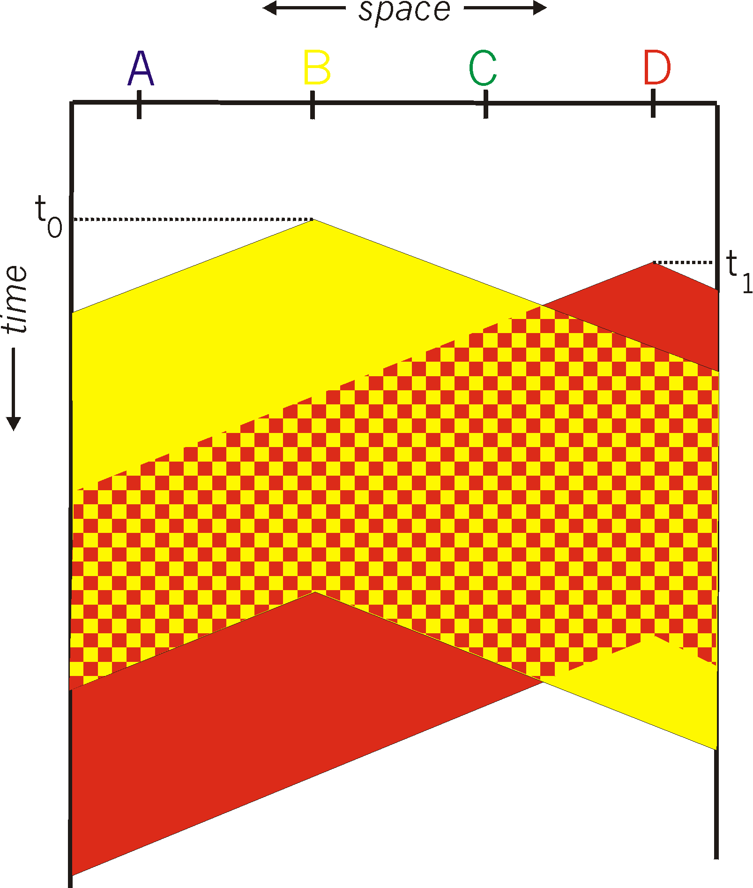
CSMA: collisions
spatial layout of nodes
collisions can still occur with carrier sensing:
propagation delay means two nodes may not hear each other’s just-started transmission
collision: entire packet transmission time wasted
distance & propagation delay play role in in determining collision probability

Slide 22
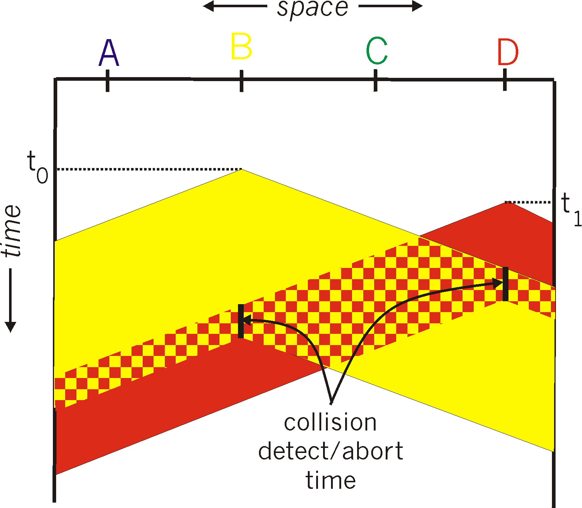
CSMA/CD:
spatial layout of nodes
CSMA/CS reduces the amount of time wasted in collisions
transmission aborted on collision detection

Slide 23
Ethernet CSMA/CD algorithm
NIC receives datagram from network layer, creates frame
If NIC senses channel:
if idle: start frame transmission.
if busy: wait until channel idle, then transmit
If NIC transmits entire frame without collision, NIC is done with frame !
If NIC detects another transmission while sending: abort, send jam signal
After aborting, NIC enters binary (exponential) backoff:
after mth collision, NIC chooses K at random from {0,1,2, …, 2^{m}-1}. NIC waits K·512 bit times, returns to Step 2
more collisions: longer backoff interval

Slide 24
CSMA/CD efficiency
T_{prop} = max prop delay between 2 nodes in LAN
t_{trans} = time to transmit max-size frame
efficiency goes to 1
as t_{prop} goes to 0
as t_{trans} goes to infinity
better performance than ALOHA: and simple, cheap, decentralized!

Slide 25
“Taking turns” MAC protocols
channel partitioning MAC protocols:
share channel efficiently and fairly at high load
inefficient at low load: delay in channel access, 1/N bandwidth allocated even if only 1 active node!
random access MAC protocols
efficient at low load: single node can fully utilize channel
high load: collision overhead
“taking turns” protocols
look for best of both worlds!

Slide 26

“Taking turns” MAC protocols
polling:
controller node “invites” other nodes (clients)to transmit in turn
typically used with “dumb” devices
concerns:
polling overhead
latency
single point of failure (controller)
data
poll
controller
data
clients

Slide 27
“Taking turns” MAC protocols
T
token passing:
control token passed from one node to next sequentially.
token message
concerns:
token overhead
latency
single point of failure (token)
(nothing
to send)
T
data

Slide 28
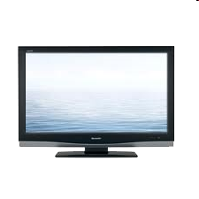


Cable access network: FDM, TDM and random access!
Internet frames, TV channels, control transmitted
downstream at different frequencies
cable headend
…
CMTS
…
splitter
cable
modem
ISP
cable modem
termination system
multiple downstream (broadcast) FDM channels: up to 1.6 Gbps/channel
single CMTS transmits into channels
multiple upstream channels (up to 1 Gbps/channel)
multiple access: all users contend (random access) for certain upstream channel time slots; others assigned TDM

Slide 29
Cable access network:
MAP frame for
Interval [t1, t2]
CMTS
Downstream channel i
Upstream channel j
cable headend
t₁
t₂
Residences with cable modems
Minislots containing
minislots request frames
Assigned minislots containing cable modem
upstream data frames
DOCSIS: data over cable service interface specificaiton
FDM over upstream, downstream frequency channels
TDM upstream: some slots assigned, some have contention
downstream MAP frame: assigns upstream slots
request for upstream slots (and data) transmitted random access (binary backoff) in selected slots

Slide 30
Summary of MAC protocols
channel partitioning, by time, frequency or code
Time Division, Frequency Division
random access (dynamic),
ALOHA, S-ALOHA, CSMA, CSMA/CD
carrier sensing: easy in some technologies (wire), hard in others (wireless)
CSMA/CD used in Ethernet
CSMA/CA used in 802.11
taking turns
polling from central site, token passing
Bluetooth, FDDI, token ring

Slide 31
Exercise
Question 1:Suppose that a packet’s payload is shown below:
11001010 01001000 01110100 01010100 10010100 11101011 01110110 00011000 11100001 10000000
1. Compute the two-dimensional parity bits for the 16 columns.
2. Compute the two-dimensional parity bits for the 5 rows
11001010 01001000 01110100 01010100 10010100 11101011 01110110 00011000 11100001 10000000 10111101 01101111
11001010 01001000 0 01110100 01010100 1 10010100 11101011 1 01110110 00011000 1 11100001 10000000 1

Slide 32
Exercise
Question 1: Both the payload and parity bits are shown. One of these bits is flipped.
00111110 00000100 0 10010101 10010011 1 11000101 01110100 0 00101000 10010100 1 01000101 00011000 1 00000011 01101111 0
Indicate the row and column with the flipped bit (format as: x,y), assuming the top-left bit is 0,0
The bit that was flipped is (16,1):
00111110 00000100 0 10010101 10010011 1 11000101 01110100 0 00101000 10010100 1 01000101 00011000 1 00000011 01101111 0

Slide 33
Exercise
Question 3: Assume that there are 3 active nodes, each of which has an infinite supply of frames they want to transmit, and these frames have a constant size of L bits. If two or more frames collide, then all nodes will detect the collision. There are two versions of the Aloha protocol: Slotted and Pure. In this problem we will be looking at the efficiency of these two variations. In the case of Slotted Aloha, frames will be sent only at the beginning of a time slot, frames take an entire time slot to send, and the clocks of all nodes are synchronized. Please round all answers to 2 decimal places.
1. Given a probability of transmission p = 0.36, what is the maximum efficiency?
Slotted ALOHA: Np(1 - p)^(N - 1) = 3 * 0.36 * (1 - 0.36)^(3 - 1) = 0.44 or 44% efficiency.
Pure ALOHA: Np(1 - p)^2(N - 1) = 3 * 0.36 * (1 - 0.36)^2(3 - 1) = 0.18 or 18% efficiency.
2. Given a probability of transmission p = 0.74, what is the maximum efficiency?
Slotted ALOHA: Np(1 - p)^(N - 1) = 3 * 0.74 * (1 - 0.74)^(3 - 1) = 0.15 or 15% efficiency.
Pure ALOHA: Np(1 - p)^2(N - 1) = 3 * 0.74 * (1 - 0.74)^2(3 - 1) = 0.01 or 1% efficiency.

